Slide 1
Heartfit
A journey to wellness through data-driven insights

Slide 2
hypothesis
Objective:
A non-technical project that focuses on raising awareness about heart health and promoting positive lifestyle changes, including BMI management. Explore the relationship between heart disease and BMI using data-driven insights which provide valuable information and a holistic approach to health and wellness.
Hypothesis:
H0: There is no statistical significant difference between BMI categories in experiencing Heart Disease.
Ha: There is a statically significant difference between BMI categories in experiencing Heart Disease

Slide 3
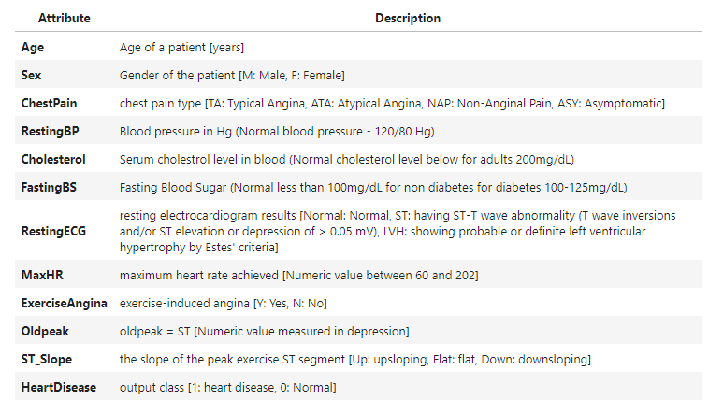
About datasets
Primary Dataset: Heart Failure Prediction Dataset
Secondary Dataset: BMI Dataset
Attributes:
Sex: Male / Female
Height: Number (cm)
Weight: Number (Kg)
Index:
0 – Extremely Weak
1 – Weak
2 – Normal
3 – Overweight
4 – Obesity
5 – Extreme Obesity

Slide 4
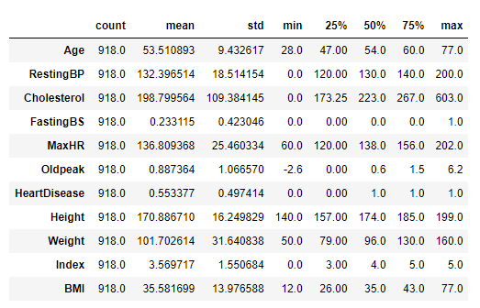
Dataset description
15 columns
No null values
No duplicates
Data Type:
5 Object
1 Float
9 Integer
Number of Samples: 918
Number of Columns: 17
Key Mean Values:
Age: 53 yrs
Maximum Heart Rate: 136.8
Weight: 101.7 kgs
BMI: 35

Slide 5
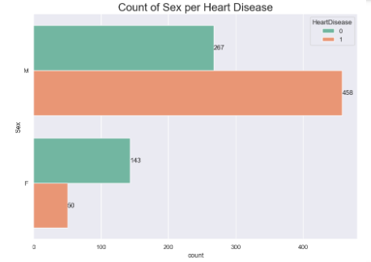
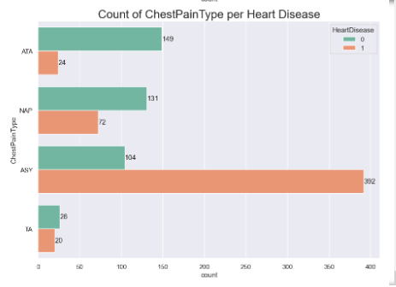
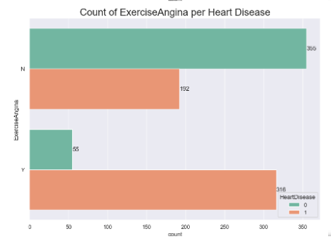
Exploring categorical features
Categorical features with an impact on heart disease:
Males more than females
Asymptomatic (ASY) Chest Pain
Those with exercise induced angina

Slide 6
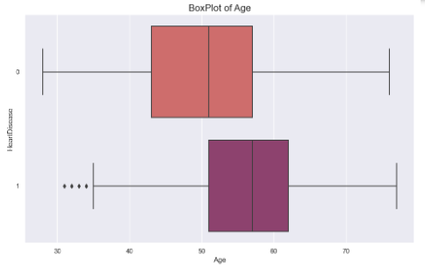
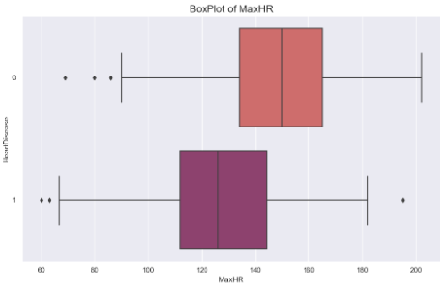
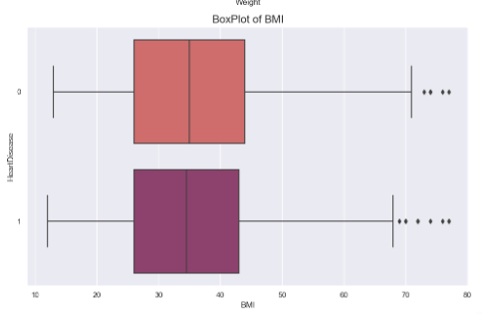
Exploring numeric features
Older people are seen to be more prone to heart disease than their younger counterparts
The mean age of those without heart disease is 50 yrs, while the average age for those with heart disease is older, 55 yrs.
The MaxHR is higher for those without heart disease than those with heart disease.
The BMI distribution for those with and without heart disease is similar.

Slide 7
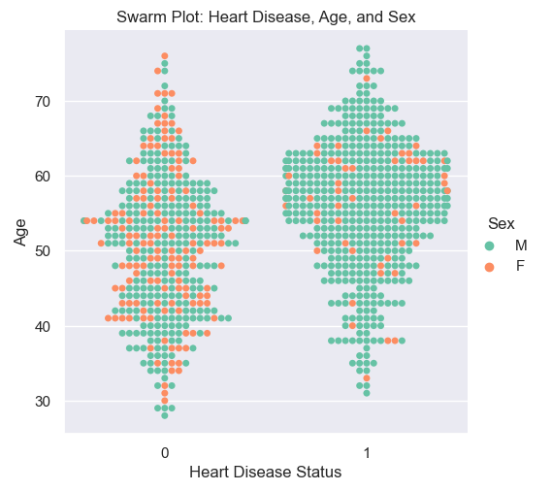
Bivariate visualizations
Older males indicate higher chances of heart disease than their female counterparts.
The swarm plot indicates more women without heart disease.

Slide 8
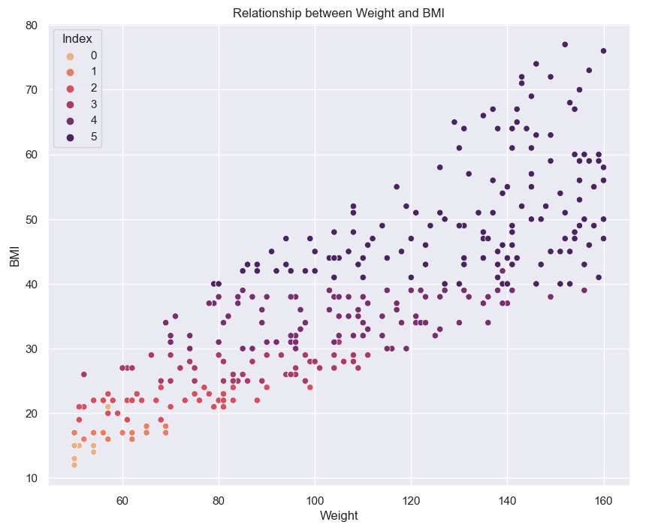
Weight and BMI
The scatter plot indicates a strong positive correlation between weight and BMI, as weight increases, BMI also tends to increase.

Slide 9
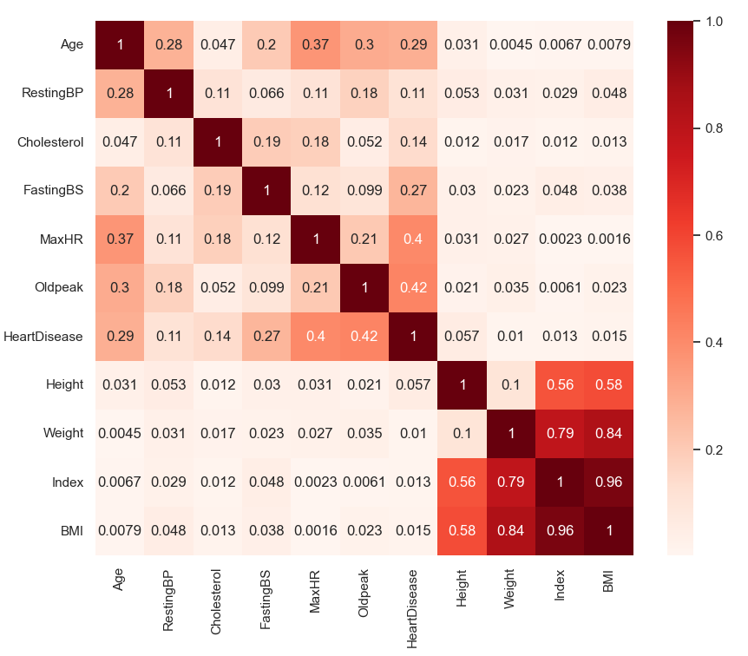
Correlation between features
There is a somewhat positive correlation between Heart Disease and MaxHR, Oldpeak, and however, there is potentially non-linear correlation between the other variables, including Heart Disease and BMI.
Height and weight show a strong positive correlation to BMI as expected.

Slide 10
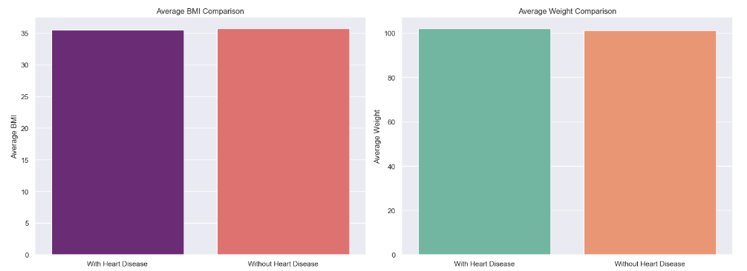
Avg BMI & avg Weight comparisons with heart disease
Avg BMI for individuals with heart disease: 35.47 – Obese.
Avg BMI for individuals without heart disease: 35.72 – Obese.
Avg Weight for individuals with heart disease: 102.05kgs.
Avg. weight for individuals without heart disease: 101.28 kgs
The similarity in the mean BMI and mean Weight for individuals with and without heart disease shows that there are other factors that determine the risk of heart disease.

Slide 11
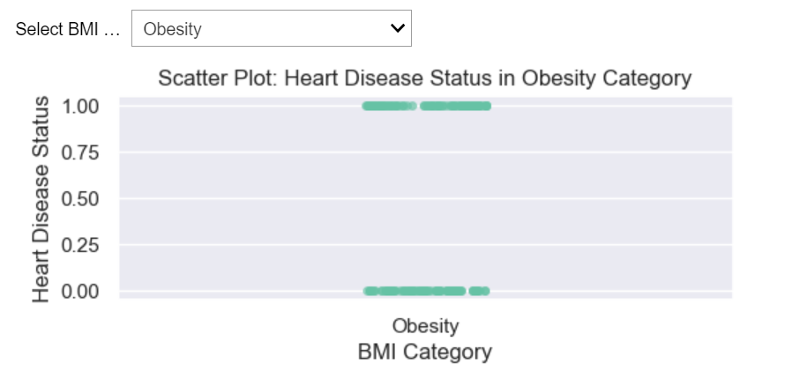
Interactive Dashboards
This interactive dashboard creates a dropdown menu where the user can select different BMI categories, and the scatter plot will dynamically update based on the users BMI category selection.

Slide 12
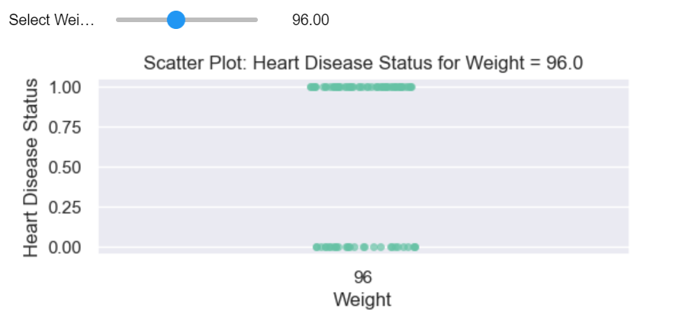
Interactive dashboard cont…
This interactive dashboard creates a slider where the user can select different weights, and the scatterplot will dynamically update based on the users selected weight.

Slide 13
Conclusion – Statistical Tests
Heart Disease and BMI
Mann-Whitney U Statistic: 102383
P-Value: 0.659
There is no statistically significant difference in BMI between individuals with and without heart disease
Heart Disease and Weight
Mann-Whitney U Statistic: 105383.5
P-Value: 0.755
There is no statistically significant difference in Weight between individuals with and without heart disease
Heart Disease and Gender
Chi-square statistic: 84.145
P-Value: 4.597
There is a significant association between gender and heart disease.

Slide 14
Conclusion - Recommendations
Develop Gender-Tailored Interventions: since gender differences are significant, consider developing interventions or public health campaigns that are tailored to the specific needs of each gender. Since males show a higher risk of heart disease, targeted campaigns should focus on promoting cardiovascular health measures that are particularly relevant to men.
Explore other Gender-Related Factors: since gender is a significant factor in heart disease, look at additional gender related variables that may contribute to the observed differences. Consider factors such as hormonal influences, lifestyle choices, and healthcare-seeking behaviours.
Explore Additional Variables & Longitudinal Study: since BMI alone did not show a significant difference in relation to heart disease, consider exploring additional variables or risk factors, i.e., diet physical activity, cholesterol levels, and blood pressure. Additionally, observe changes in BMI and heart disease risk over time. This might uncover temporal patterns that cross-sectional analyses might overlook.
Potential Outcomes:
Increased awareness of the correlation between the factors that influence heart disease.
Adoption of healthier habits and lifestyle changes among users.
Development of a user-friendly platform that encourages data-driven wellness decisions.

Slide 15
Conclusion – Future work
For users to have a better experience with the dashboard, create an interactive dashboard using Dash, a web application framework for building interactive web applications with Python.
This interactive feature will allow for users to access a provided local URL in their web browser to interact with the dashboard.
The dashboard will also extend the app by adding more interactive elements or visualizations based on this dataset and user exploration needs.

Slide 16
Appendix
Primary Dataset - https://www.kaggle.com/datasets/fedesoriano/heart-failure-prediction/data
Secondary Dataset - https://www.kaggle.com/datasets/yasserh/bmidataset
Research Studies:
https://pubmed.ncbi.nlm.nih.gov/29490333/#:~:text=Higher%20BMI%20had%20the%20strongest,in%20younger%20and%20older%20adults.
https://www.ahajournals.org/doi/10.1161/JAHA.121.023667

Slide 17


